Slide 1
Ada Lovelace Day Hackathon Finals
Sonnet-Generator

Slide 2
—Women in STEM
“When you’re pursuing any career really, but especially in one in technology, find your passion. And don’t let anything stand in your way..”

Slide 3
TABLE OF CONTENTS
01
04
Team Details
02
05
Technologies Used
03
Solution Architecture
Phases
Frameworks/Tools

Slide 4
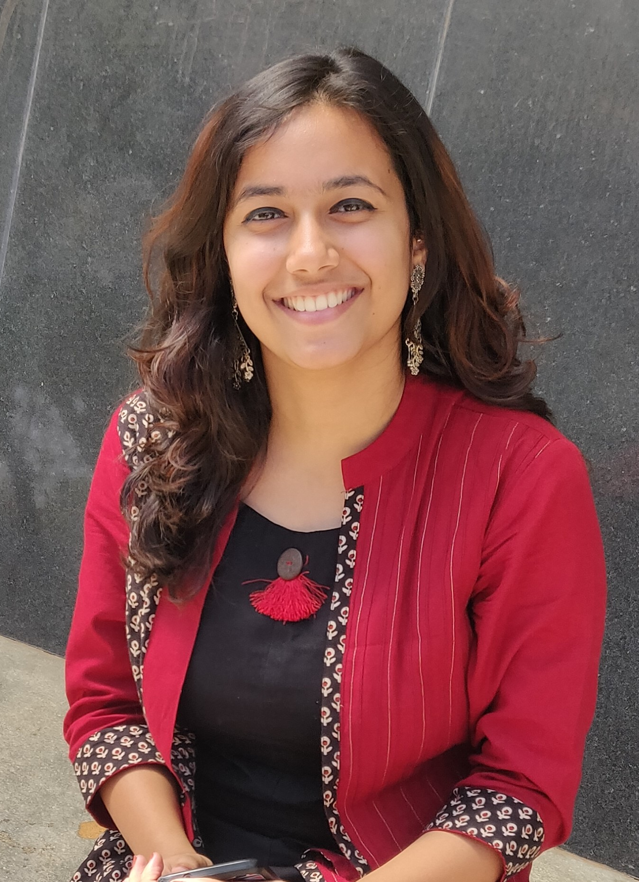
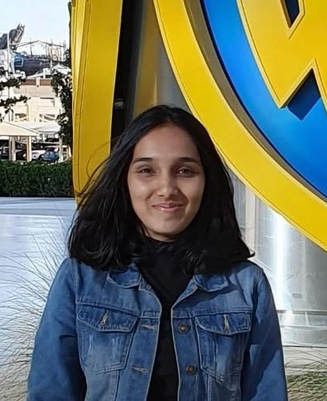
THE TEAM
Risha Dassi
Nikitha Srikanth
Contribution: UI/UX
Expertise: Frontend
Contribution: Model Building
Expertise: Backend

Slide 5
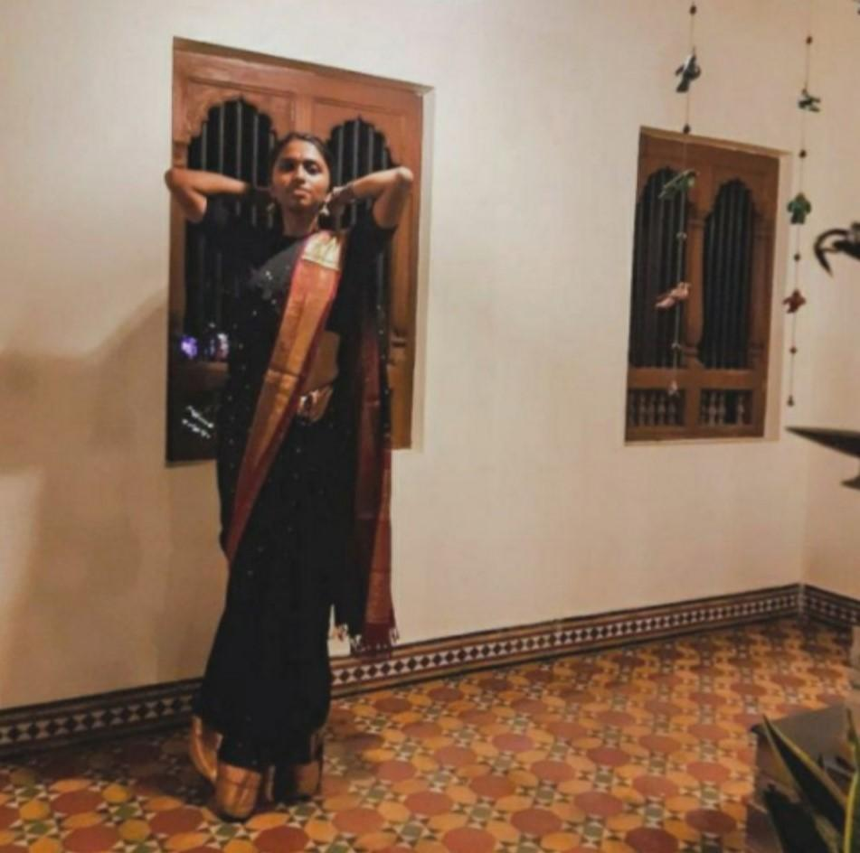
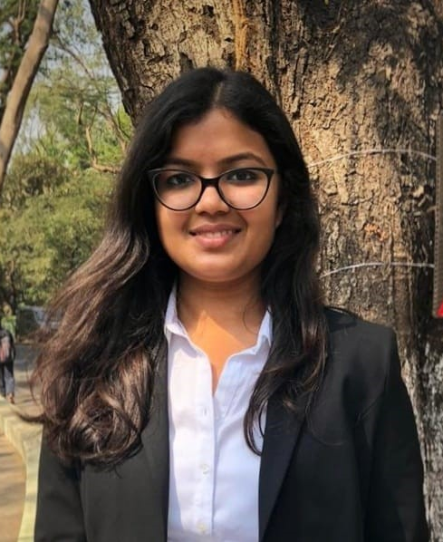
THE TEAM
Sai Keerthana
Sakshi Kamal
Contribution: Model Deployment
Expertise: Backend
Contribution: UI/UX
Expertise: Frontend

Slide 6
Technologies Used
Bootstrap 4
Flask
Google Colab
GitHub
Heroku
Tensorflow

Slide 7
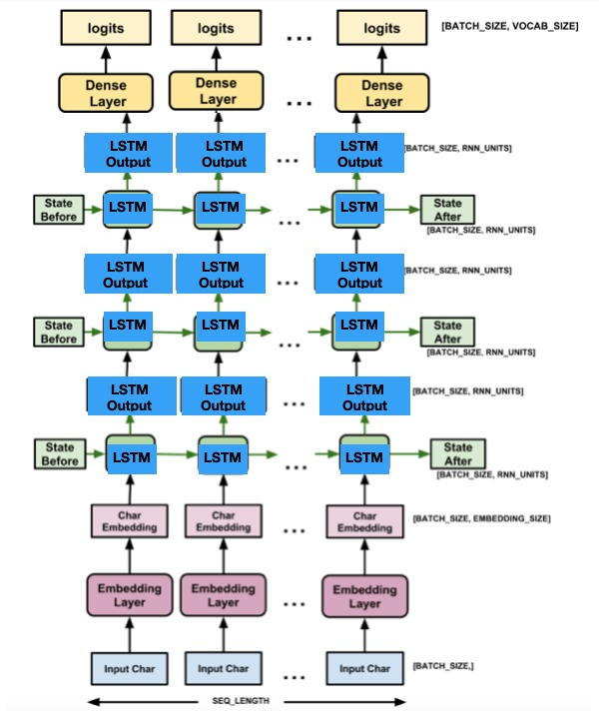
Solution Architecture
Sonnet generator

Slide 8
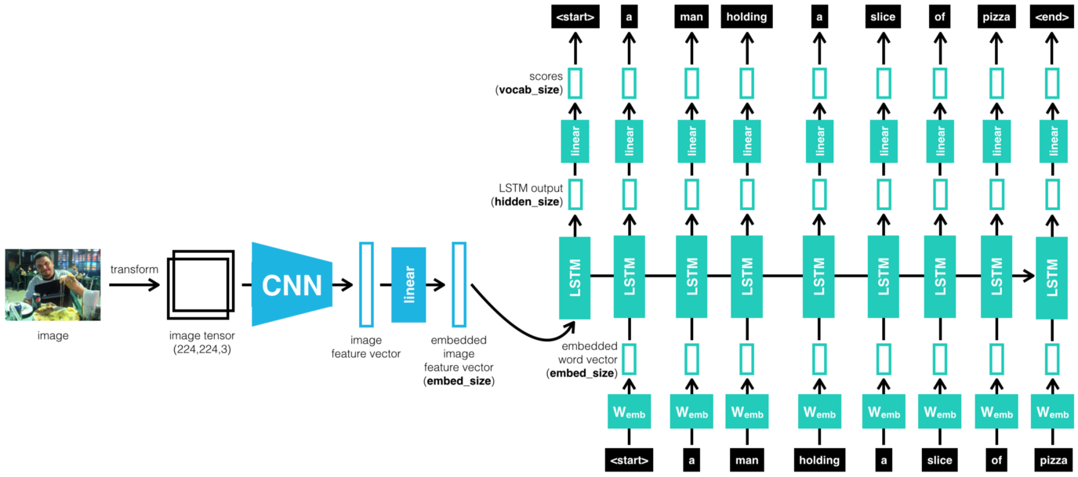
Solution Architecture
Image Captioning

Slide 9
Phases
Visualization
Data Exploration
Modeling

Slide 10
Data Exploration
Visualization
Processing
Research
Visualizing Data
Filtering/Processing the data
Identifying important data

Slide 11
Data Exploration (Cont.)
Research- Explored the various possible datasets which would be suitable for our architecture. The provided dataset (cocodataset) was extremely large and therefore would take a lot of time to train. We used the dataset MSCOCO for our model.
Processing- The image data is resized and preprocessed. This enables us to generate caption dataset and image feature vectors.
Visualization- To generate the required captions, and visualize attention weights, the model is evaluated.

Slide 12
2. Modeling
Choosing a Model
Training the Model
Evaluating the Model
Parameter Tuning
Making Predictions

Slide 13
2. Modeling (Image Captioning)
The captioning model is a combination of two separate architecture that is CNN (Convolutional Neural Networks)& RNN (Recurrent Neural Networks) and in this case LSTM (Long Short Term Memory), which is a special kind of RNN that includes a memory cell, in order to maintain the information for a longer period of time.
CNN is used to generate feature vectors from the spatial data in the images and the vectors are fed through the fully connected linear layer into the RNN architecture in order to generate the sequential data or sequence of words that in the end generate description of an image by applying various image processing techniques to find the patterns in an image.

Slide 14
2. Modeling (Sonnet Generator)
For Sonnet Generation, the model is character-based and does not learn the meaning or context of words. Since Sonnets are abstract, it is sufficient for the model to learn the sequences of characters alone. With a sequence of 100 characters, it is able to predict a much longer sequence of text with a proper structure.
The model uses a special type of Recurrent Neural Network (RNN) called a Long Short Term Memory (LSTM) Network to remember relevant patterns in previous sequences, forget unnecessary details, and predict the next sequence.

Slide 15
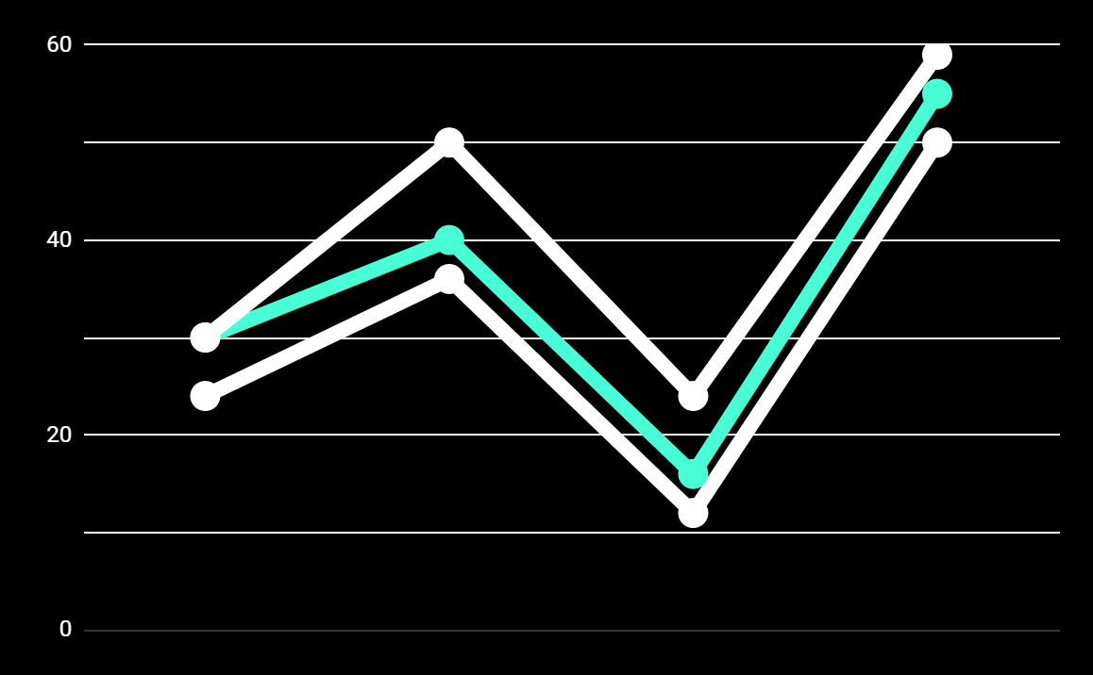
3. Visualization
This phase is relatively simple in the sense it only entails the amalgamation of the first two phases and the final visceral working of the model.
In this stage, the trained image captioning model is used when the user inputs the image file. Captions on this image are generated and fed to the sonnet generator, which then displays the required.

Slide 16
Frameworks/Tools
Heroku- Paas
Bootstrap for UI
Flask- Web App
For the UI/UX, we have designed a basic layout using HTML, CSS, along with BootStrap4.
Flask framework for developing the backend for the web application.
The trained model is loaded here.
Heroku is used to publish our web application.

Slide 17
THANKS!

